Slide 1
TAPI Wireless Transport Use Case
Lyndon Ong
Ciena
Aug 1, 2017

Slide 2
Contribution Number: oif2017.343.00
Working Group(s): Networking Interoperability WG
TITLE: TAPI Wireless Transport Use Case
SOURCE: Lyndon Ong, Ciena
DATE: Aug 1, 2017
ABSTRACT: Discusses potential addition of a Wireless Transport domain as a Use Case in the 2018 Demo
Notice: This contribution has been created to assist the Optical Internetworking Forum (OIF). This document is offered to the OIF solely as a basis for discussion and is not a binding proposal on the companies listed as resources above. Each company in the source list, and the OIF, reserves the rights to at any time to add, amend, or withdraw statements contained herein.
This Working Text represents work in progress by the OIF, and must not be construed as an official OIF Technical Report. Nothing in this document is in any way binding on the OIF or any of its members. The document is offered as a basis for discussion and communication, both within and without the OIF.
For additional information contact:
The Optical Internetworking Forum, 48377 Fremont Blvd,
Suite 117, Fremont, CA 94538
510-492-4040 phone  info@oiforum.com
© 2014 Optical Internetworking Forum

Slide 3
ONF Wireless Transport Work
Wireless Transport Project
Defining an Information Model for Wireless Transport equipment
Model assumes that Wireless Transport is one span or link
Any switching is at a higher layer
Also single vendor is assumed to provide both ends of the link
Technology is still not interoperable at the media layer
IM provides a common model for control using NETCONF/YANG from the SDN Controller

Slide 4
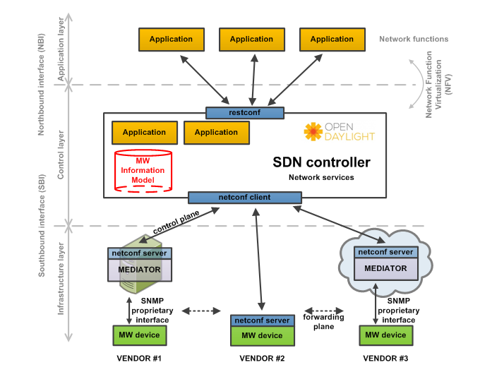
Wireless Transport PoC ARCHITECTURE
@2017 Open Networking Foundation

Slide 5
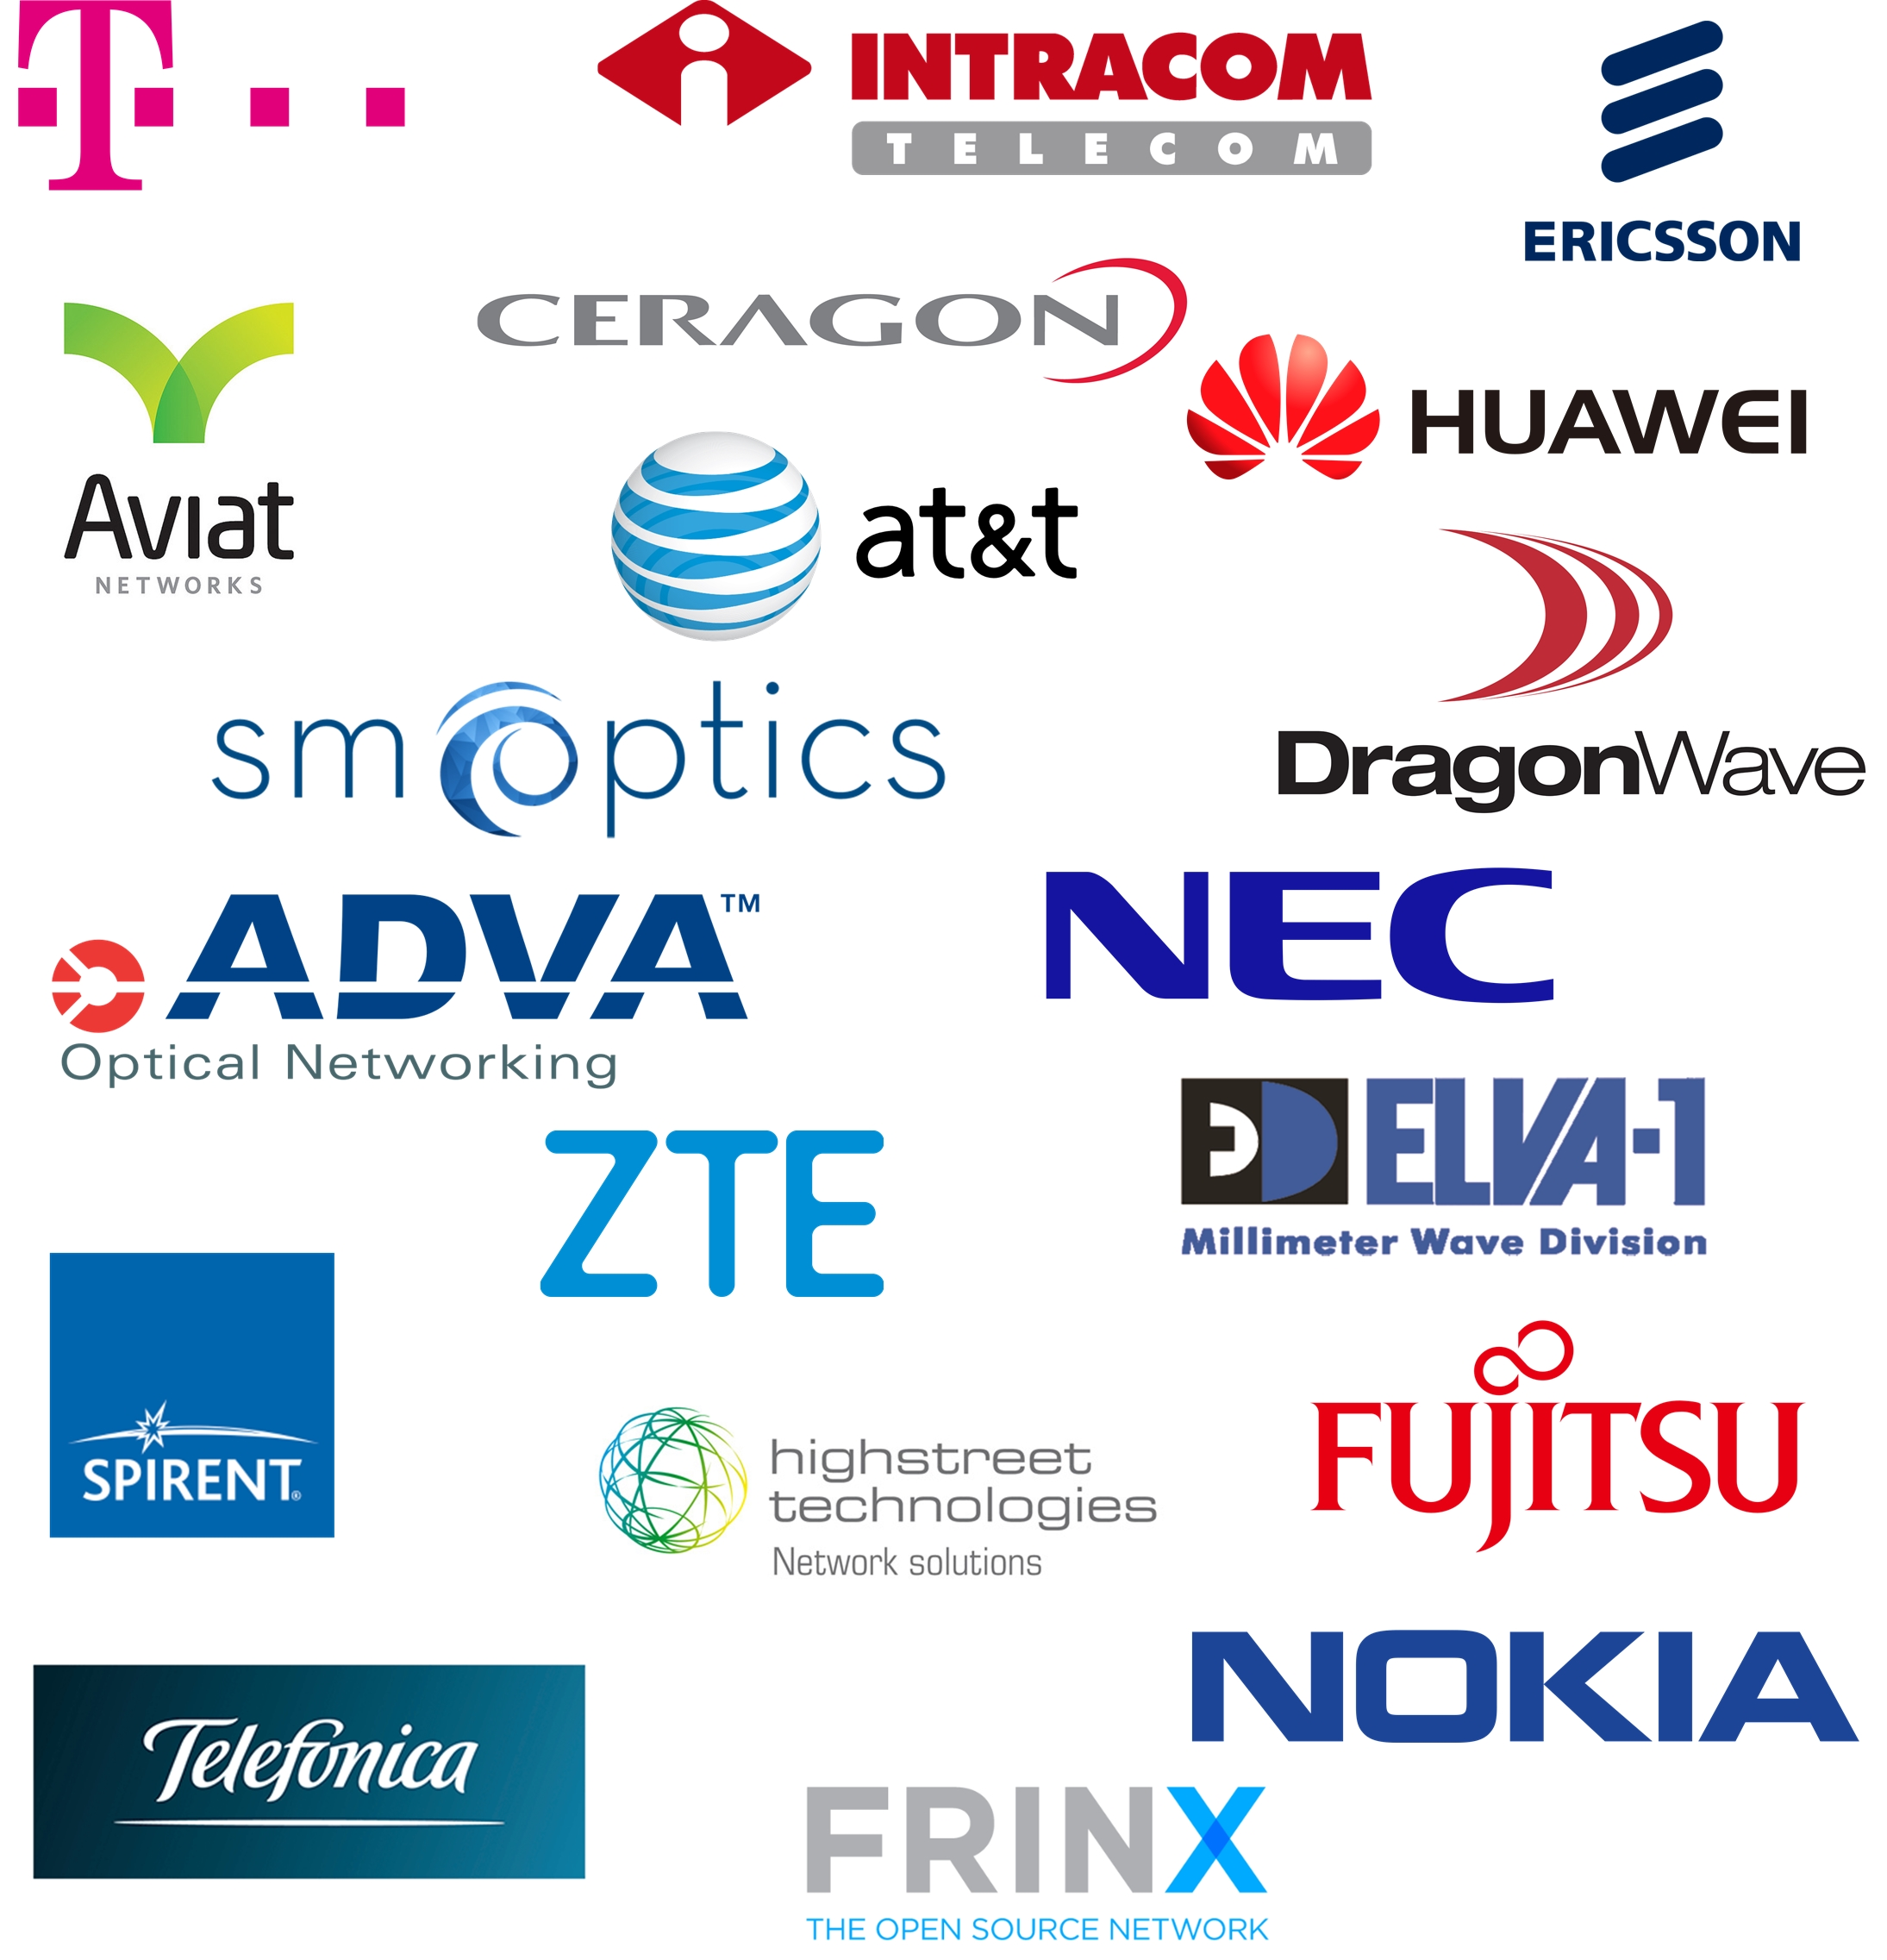
WT 4th PROOF OF CONCEPT
Scope of the PoC:
Demonstrate the microwave model implemented in a multivendor microwave network with all parameters modeled by ONF TR-532 and managed via ODL Boron SR1 version.
Integrate the model for 1588v2 transport profile defined in “draft-ietf-tictoc-1588v2-yang-05” into MW devices.
Demonstrate a basic connection-oriented Ethernet model integrated in the ONF Core model with re-routing capabilities.
Proof some new use cases using the models implemented.
19 COMPANIES INVOLVED (12 ONF MEMBERS, 7 CONTRIBUTORS).
→ 14 PRODUCT VENDORS
→ 3 TELCO OPERATORS
→ 2 SW PROVIDERS
MORE THAN 35 PEOPLE ATTENDING THE EVENT.
@2017 Open Networking Foundation

Slide 6
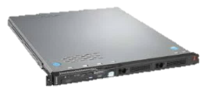
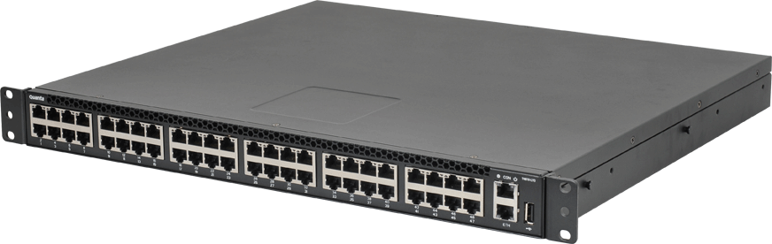
ONF GENERAL ARCHITECTURE
Global Orchestrators
Open Source: ONAP, Open Source MANO
Service APIs: TOSCA, RESTful
Solutions Platforms
M-CORD
R-CORD
E-CORD
Alternative VNF Frameworks
(e.g. OPNFV)
CORD
Standards
&
Interworking APIs
VNFs
New ONF Scope of Focus
Network Intent-Based APIs
Control Plane
ONOS
Alternative Controllers (e.g. ODL)
Control
(OpenFlow, P4)
Config
(NetConf/Yang, OpenConfig)
WT POC Scope
Programmable Forwarding Plane
Open Source: Switch OS, FBOSS, SONIC, ONL, ONIE
Disaggregated boxes: Packet switch, ROADM, eNodeB, OLT, RAN …
@2017 Open Networking Foundation

Slide 7
Potential for Demo
Add Wireless Transport as an additional Domain type
Multi-technology with Ethernet common interdomain interface
Shows common model at API level with integration of multiple media and technology types
Issues
Need wireless transport vendor involved (via ONF)
Need SDN Controller that supports WT IM as well as TAPI NBI (ODL?)
Need to see the level of interest by carriers (seems some interest)

